Slide 1
PUBLIC-KEY AUTHENTICATED ENCRYPTION WITH CIPHERTEXT UPDATE AND KEYWORD SEARCH
By
AKSHAYA V - 422420104004
KAVIYA V - 422420104702
SINDHUJA R - 422420104032
Guided By
Ms. P. Sathya, M.Tech.,
TEACHING FACULTY,
DEPARTMENT OF COMPUTER SCIENCE AND ENGINEERING,
UNIVERSITY COLLEGE OF ENGINEERING TINDIVANAM.

Slide 2
PAPER DETAILS
Title :Public-Key Authenticated Encryption With Keyword Search Supporting Constant Trapdoor Generation and Fast Search
Author :Hongbo Li , Qiong Huang , Jianye Huang , and Willy Susilo.
DOI :10.1109/TIFS.2022.3224308
Published Year :1 June-2023
Published in :IEEE Transactions on Information Forensics and Security

Slide 3
OVERVIEW
Introduction
Abstract
Literature Survey
Problem Statement
Objectives
Scope
System Architecture
System Model
Module Description
Algorithm Description
UML Diagrams
Implementation
Performance Analysis
Conclusion
Future Works
References

Slide 4
INTRODUCTION
Electronic medical records (EMRs) are crucial components of hospital information systems, managing patient data like medical history and diagnoses.
EMR takes up a large amount of space due to the large number of patients.
Ensuring information security is critical, as network threats could lead to data breaches, posing serious privacy risks to patients.
To address this issue, hospitals can encrypt EMRs and outsource them to the cloud under the supervision of a data administrator.

Slide 5
INTRODUCTION (Contd.)
Existing public key encryption scheme may not suffice for frequent queries from medical researchers.
Public key authenticated encryption with keyword search (PAEKS) is a promising solution, but it faces scalability issues, with trapdoor generation linearly increasing with the number of users.
The required number of trapdoors per query is constant in PAUKS scheme, instead of the linearly expanding as the number of senders increases in PAEKS.

Slide 6
ABSTRACT
To improve the quality of medical care and reduce unnecessary medical errors, electronic medical records(EMRs) are used in hospitals.
A secure and efficient cloud storing and sharing method can save the hospital local storage.
Public key authenticated encryption with ciphertext update and keyword search (PAUKS) allows for encrypted querying without decryption, reducing computational and communication overhead.
It supports constant trapdoor generation and fast search, addressing challenges in managing and securing EMRs.

Slide 7
ABSTRACT (Contd.)
An inverted index can be used to accelerate the search process. It is secure against inside keyword guessing attacks.
PAUKS scheme enhances data access control and privacy protection for sensitive medical information.
This scheme owns a comparable running overhead, but enjoys a higher query efficiency after ciphertexts update.

Slide 8
LITERATURE SURVEY
S. NO | AUTHOR NAME AND YEAR | TITLE | ALGORITHM (OR) TECHNIQUES | MERITS | DEMERITS
1. | D. Boneh, G. Di Crescenzo, R. Ostrovsky, and G. Persiano & 2004 | Public key encryption with keyword search | Key Generation and Searchable Encryption | Searchable Encryption, Privacy Preservation, Efficiency | Security Concerns, Keyword Leakage, Complexity
2. | H. Li, Q. Huang, J. Shen, G. Yang, and W. Susilo & 2019 | Designated server identity-based authenticated encryption with keyword search for encrypted emails | Identity-based authenticated encryption and keyword search | Secure E-mail communication, Designated server | Trust assumption, Single point of failure, Complexity

Slide 9
LITERATURE SURVEY (Contd.)
S. NO | AUTHOR NAME AND YEAR | TITLE | ALGORITHM (OR) TECHNIQUES | MERITS | DEMERITS
3. | Y. Lu, J. Li, and Y. Zhang & 2021 | Secure channel free certificate-based searchable encryption withstanding outside and inside keyword guessing attacks | Certificate-based cryptography | Decentralized deployment, Searchable Efficient | Dependence on trust infrastructure, Performance overhead, Key management
4. | R. Chen, Y. Mu, G. Yang, F. Guo, and X. Wang & 2016 | Dual-server public-key encryption with keyword search for secure cloud storage | Key Generation, Encryption, Searchable Encryption | Enhanced Security, Privacy Preservation, Scalability | Increased Complexity, Communication Overhead, Dependency on Server Security, Performance Overhead

Slide 10
LITERATURE SURVEY (Contd.)
S. NO | AUTHOR NAME AND YEAR | TITLE | ALGORITHM (OR) TECHNIQUES | MERITS | DEMERITS
5. | L. Xu, Z. Sun, W. Li, and H. Yan & 2020 | Delegatable searchable encryption with specified keywords for EHR systems | Delegatable searchable encryption (DSE) | Security, Privacy Preservation, Efficient Search, Delegatability | Performance Overhead, Complexity, Keyword Leakage, Scalability
6. | M. Deng, W. Song, M. Ma, H. Li, and M. Israr & 2022 | Efficient designated server proxy re-encryption with keyword search for big data | Designated server proxy re-encryption (DSPRE) with keyword search for big data | Privacy Preservation, Efficient Search, Scalability, Selective Access Control | Complexity, Performance Overhead, Key Management, Security Assumptions

Slide 11
PROBLEM STATEMENT
Number of trapdoor per query is relatively high which causes inefficient searching and communication overhead.
Existing public key encryption schemes typically do not allow for searching encrypted data that may require revealing sensitive information to the search server.

Slide 12
OBJECTIVES
To generate a constant size trapdoor which reduces communication overhead, storage cost and improve efficient searching.
To allow authorized users to search over encrypted data using specific keywords without decrypting the data.

Slide 13
SCOPE
Cloud Computing Services
Financial Services
Healthcare Sector
E-Mail

Slide 14
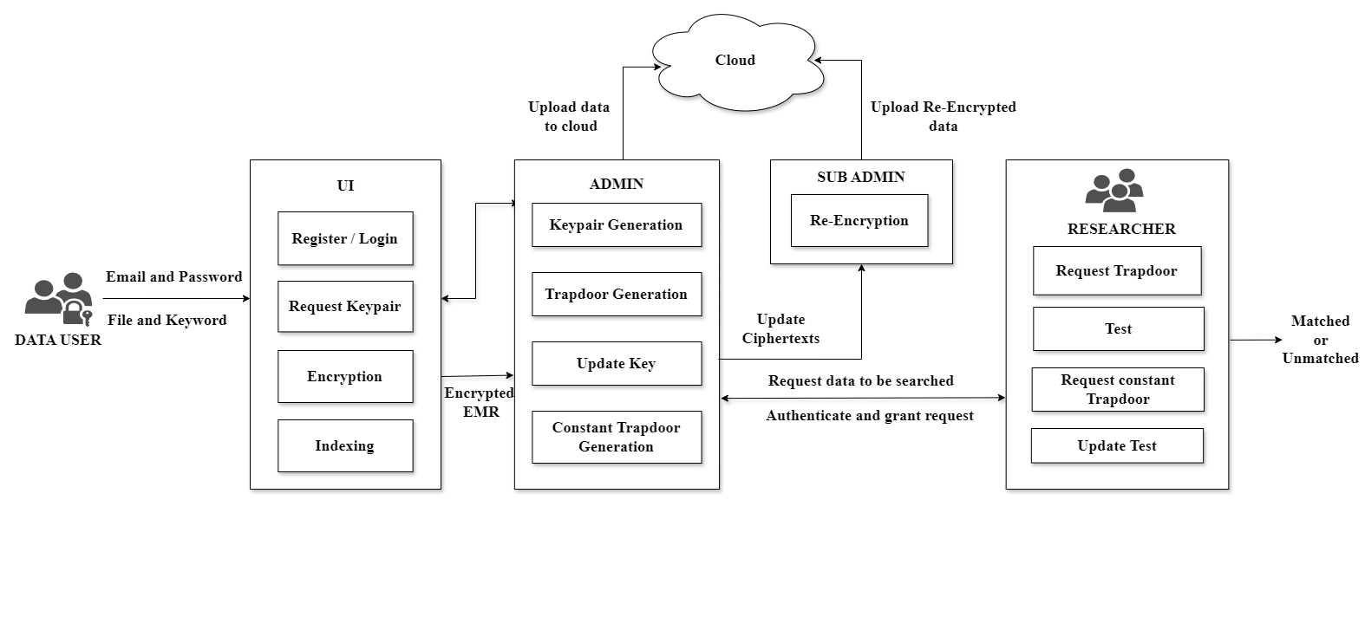
SYSTEM ARCHITECTURE

Slide 15



SYSTEM MODEL
Cloud Server
Get Ciphertext(4)
Trapdoor verification(3)
Re- encryption(6)
Upload file(2)
Trapdoor Request
Updated key(5)
Secure Channel
External user
Sub- Administrator
Administrator
Encrypted
file(1)
Encrypted file(1)
Encrypted file(1)
Sender 1
Sender 2
Sender 3

Slide 16
MODULE DESCRIPTION
DATA USER
Users initiate their journey by registering themselves, providing necessary information to create their account securely.
Once registered, users access the system through a seamless login process, where their identity is verified using PAUKS authentication protocols, guaranteeing secure access tailored to their permissions.
With access granted, users can effortlessly transmit file to the system's administrators, confident in the confidentiality and integrity of their submissions.

Slide 17
MODULE DESCRIPTION (Contd.)
KEY GENERATION
Public key authentication and encryption involve a process where systems can securely authenticate their identity or encrypt messages using a pair of cryptographic keys.
This pair consists of a public key, which can be shared openly, and a private key, which must be kept secret.
This process is pivotal for establishing trust and confidentiality within the system.
These keys form the foundation of secure communication, enabling users to verify their identities and encrypt sensitive information.

Slide 18
MODULE DESCRIPTION (Contd.)
ENCRYPTION
Encryption process uses sender’s secret key, receiver’s public key and keyword for encryption and produce ciphertext as output.
Encryption is involved in the public key authentication process primarily for security reasons, enhancing the confidentiality, integrity, and authenticity of the communication between parties.

Slide 19
MODULE DESCRIPTION (Contd.)
INDEXING
Indexing in the context of searchable encryption, such as the Public-Key Authenticated Encryption with Keyword Search (PAUKS) scheme, involves creating data structures that map keywords to encrypted data without the need for decryption.
This indexing mechanism accelerates the search process by allowing users to quickly retrieve relevant encrypted information based on specific keywords.
By utilizing indexing, users can efficiently search and access encrypted data without compromising data security and privacy.

Slide 20
MODULE DESCRIPTION (Contd.)
TRAPDOOR GENERATION
Trapdoor Generation generates trapdoors which are special cryptographic keys or tokens that allow users to perform secure searches on encrypted data without revealing the contents of the data itself.
The trapdoor generation process involves transforming user-provided search queries into encrypted tokens that match encrypted data stored in the system.
By generating trapdoors, the module enables users to conduct efficient and privacy-preserving searches on sensitive data while mitigating the risk of unauthorized access.

Slide 21
MODULE DESCRIPTION (Contd.)
TEST
The test functionality plays a pivotal role in enabling users to efficiently retrieve relevant encrypted information based on specific keywords while maintaining data security and privacy.
Users can input search queries consisting of keywords, which are then matched against the indexed data structures.
This matching process allows for rapid identification of encrypted data associated with the specified keywords, without compromising the confidentiality of the underlying information.

Slide 22
MODULE DESCRIPTION (Contd.)
UPDATE KEY
The Update Module handles the updating of ciphertexts stored in the cloud to maintain data consistency and accuracy.
It enables the generation of updating keys for each sender to update the encrypted data securely.
The module supports for constant trapdoor generation.
Updating keys is helpful to maintain the integrity and eliminate internal attacks.

Slide 23
MODULE DESCRIPTION (Contd.)
RE-ENCRYPTION
Re-Encryption within a Public-Key Authenticated Encryption with Keyword Search (PEKS) system plays a critical role in enhancing the system's flexibility and security by allowing encrypted data to be securely transformed from one cryptographic key to another without the need to decrypt it first.
This process, known as proxy re-encryption, allows a proxy server to perform re- encryption operations without gaining access to the plaintext contents of the data, thus maintaining confidentiality throughout the transfer process.

Slide 24
MODULE DESCRIPTION (Contd.)
CONSTANT TRAPDOOR GENERATION
Constant trapdoor generation in Public-Key Authenticated Encryption with Keyword Search (PAUKS) is a vital aspect of maintaining the system's efficiency and security.
It ensures that trapdoors, which are cryptographic tokens used to search for specific keywords without exposing the encrypted data, are continually generated and available.
The trapdoor generation remains constant regardless of the number of users.

Slide 25
MODULE DESCRIPTION (Contd.)
UPDATE TEST
Update test is a process within a cryptographic system that focuses on modifying and improving the search functionality without altering the underlying data structure or compromising security.
Instead of changing the fundamental architecture, update search aims to refine search algorithms, enhance indexing mechanisms, or optimize keyword retrieval methods.
This ensures that the system remains efficient and effective in retrieving relevant information while maintaining data privacy and integrity.

Slide 26
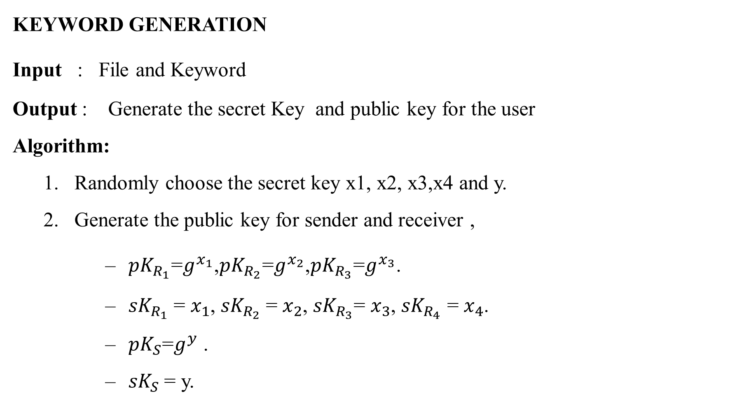
ALGORITHM DESCRIPTION
KEYWORD GENERATION
Input : File and Keyword
Output : Generate the secret Key and public key for the user
Algorithm:
Randomly choose the secret key x1, x2, x3,x4 and y.
Generate the public key for sender and receiver ,
${pK}_{R_{1}}$=$g^{x_{1}}$,${pK}_{R_{2}}$=$g^{x_{2}}$,${pK}_{R_{3}}$=$g^{x_{3}}$.
${sK}_{R_{1}}$= $x_{1}$, ${sK}_{R_{2}}$= $x_{2}$, ${sK}_{R_{3}}$= $x_{3}$, ${sK}_{R_{4}}$ = $x_{4}$.
${pK}_{S}$=$g^{y}$ .
${sK}_{S}$ = y.

Slide 27

ALGORITHM DESCRIPTION (Contd.)
ENCRYPTION
Input: ${pk}_{R}$, ${sk}_{S}$
Output: Ciphertext
Algorithm:
Generate four secure Hash functions
$H_{1}$:G $×$ {0,1}*→ $Z_{p},$ $H_{2}:G$→$Z_{p}$, $H_{3}:G$→$Z_{p}$, $H_{4}$:{0,1}*→G
Encrypts the given text.
C₁= ${\left({pK}_{R_{2}}^{H1\left({pK}_{R_{1}}^{{sK}_{S}},w\right)}.{pK}_{R_{3}}\right)}^{r1}$
C₂ = $g^{r1}$

Slide 28
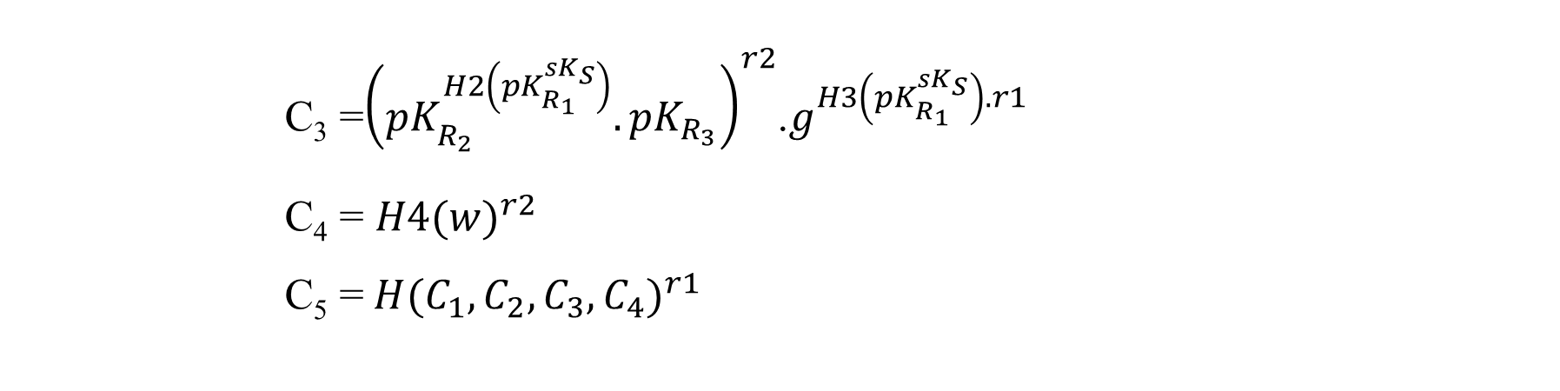
ALGORITHM DESCRIPTION (Contd.)
C₃ =${\left({pK}_{R_{2}}^{H2\left({pK}_{R_{1}}^{{sK}_{S}}\right)}.{pK}_{R_{3}}\right)}^{r2}$.$g^{H3\left({pK}_{R_{1}}^{{sK}_{S}}\right).r1}$
C₄ = ${H4(w)}^{r2}$
C₅ =${ H(C_{1}, C_{2}, C_{3}, C_{4})}^{r1}$

Slide 29
ALGORITHM DESCRIPTION (Contd.)
INSERT INDEX
Input: C, H
Output: H
Algorithm:
Generate the inverted index H = <No., Label Cipher, Pointer >
Set the ptr = H and iseql=0
Compute while loop for the equality test and set the if condition,
3.1. Iseql = equality Test (PP, ptr.LabelCipher, C) is true, return H.
3.2. Else move to ptr.nextnode
4. Insert the C into ptr.Pointer.

Slide 30
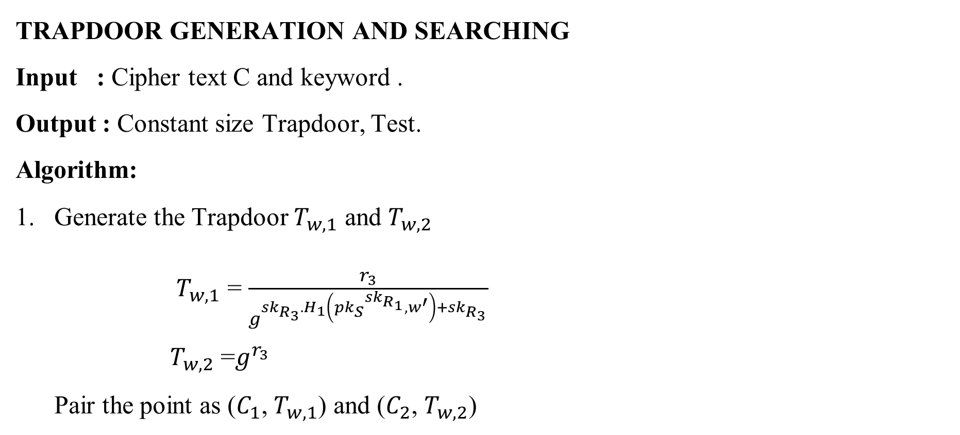
ALGORITHM DESCRIPTION (Contd.)
TRAPDOOR GENERATION AND SEARCHING
Input : Cipher text C and keyword .
Output : Constant size Trapdoor, Test.
Algorithm:
Generate the Trapdoor $T_{w,1}$ and $T_{w,2}$
$T_{w,1}$ = $\frac{r_{3}}{g^{{sk}_{R_{3}}.H_{1}\left({{pk}_{S}}^{{sk}_{R_{1}}},w^{′}\right)+{sk}_{R_{3}}}}$
$T_{w,2}$ =$g^{r_{3}}$
Pair the point as ($C_{1}$, $T_{w,1}$) and ($C_{2}$, $T_{w,2}$)

Slide 31
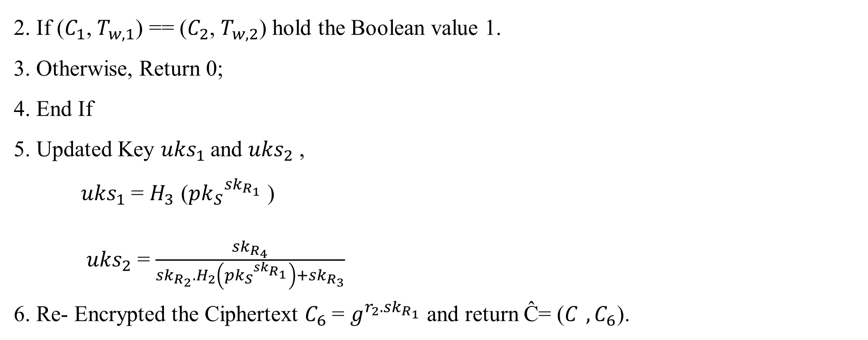
ALGORITHM DESCRIPTION (Contd.)
2. If ($C_{1}$, $T_{w,1}$) == ($C_{2}$, $T_{w,2}$) hold the Boolean value 1.
3. Otherwise, Return 0;
4. End If
5. Updated Key ${uks}_{1}$and ${uks}_{2}$ ,
${uks}_{1}$ = $H_{3}$ (${{pk}_{S}}^{{sk}_{R_{1}}}$ )
${uks}_{2}$ = $\frac{{sk}_{R_{4}}}{{sk}_{R_{2}}.H_{2}\left({{pk}_{S}}^{{sk}_{R_{1}}}\right)+{sk}_{R_{3}}}$
6. Re- Encrypted the Ciphertext $C_{6}$= $g^{r_{2}.{sk}_{R_{1}}}$ and return Ĉ= ($C_{ } ,C_{6}$).

Slide 32
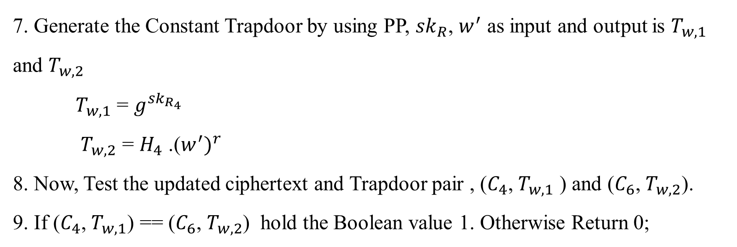
ALGORITHM DESCRIPTION (Contd.)
7. Generate the Constant Trapdoor by using PP, ${sk}_{R}$, $w^{′}$ as input and output is $T_{w,1}$ and $T_{w,2}$
$T_{w,1}$ = $g^{{sk}_{R_{4}}}$
$T_{w,2}$ = $H_{4}$ .(${w^{′})}^{r}$
8. Now, Test the updated ciphertext and Trapdoor pair , ($C_{4}$, $T_{w,1}$ ) and ($C_{6}$, $T_{w,2}$).
9. If ($C_{4}$, $T_{w,1}$) == ($C_{6}$, $T_{w,2}$) hold the Boolean value 1. Otherwise Return 0;

Slide 33
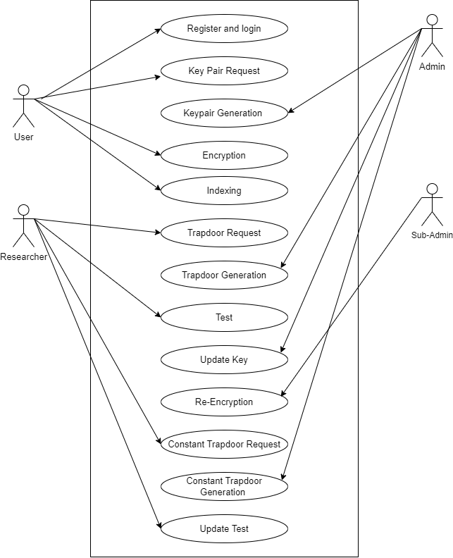
USE CASE DIAGRAM

Slide 34
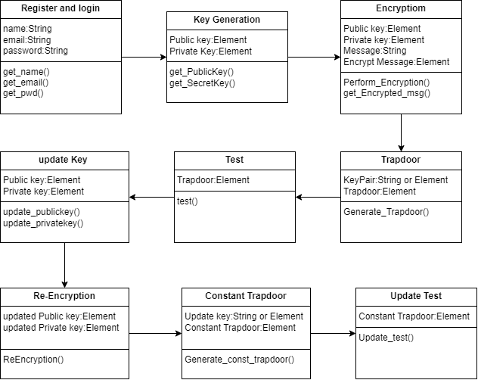
CLASS DIAGRAM

Slide 35
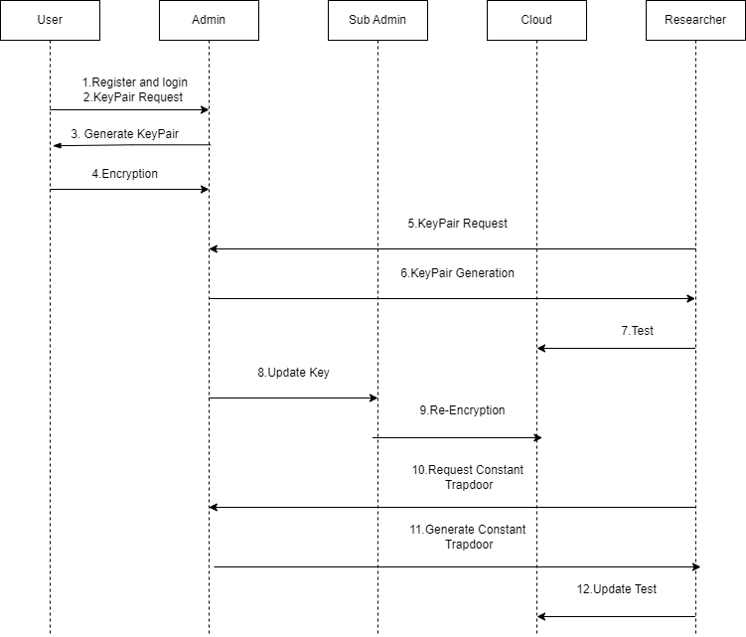
SEQUENCE DIAGRAM

Slide 36
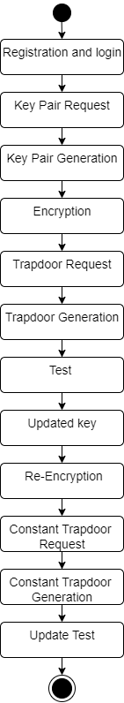
STATECHART DIAGRAM

Slide 37
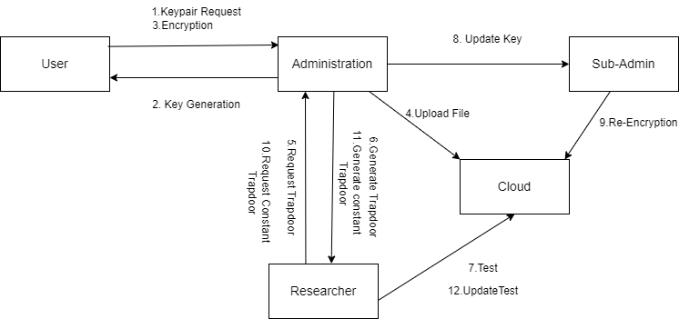
COLLABORATION DIAGRAM

Slide 38
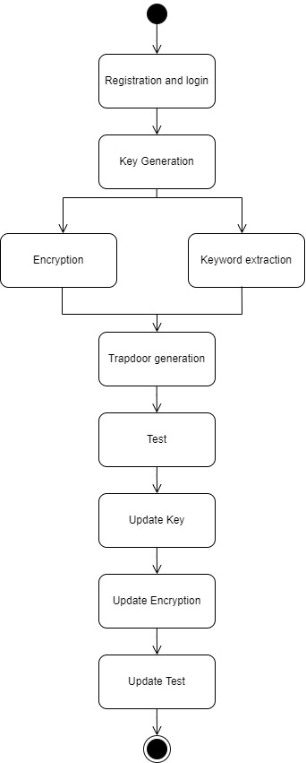
ACTIVITY DIAGRAM

Slide 39
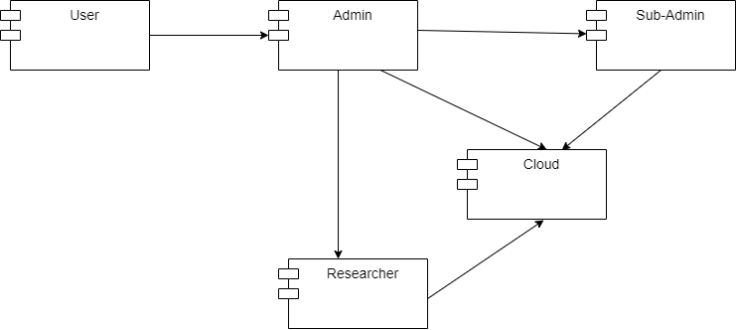
COMPONENT DIAGRAM

Slide 40
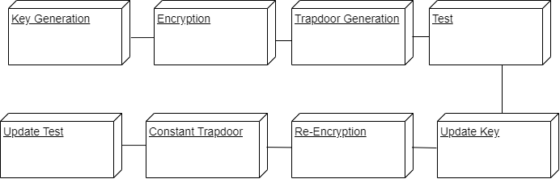
DEPLOYMENT DIAGRAM

Slide 41
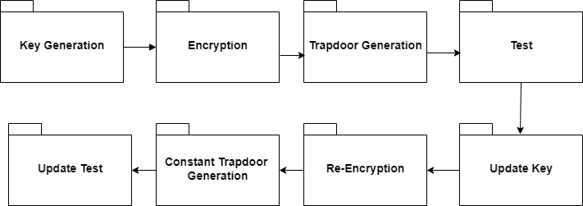
PACKAGE DIAGRAM

Slide 42
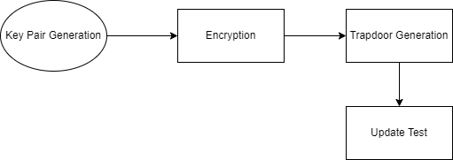
DATA FLOW DIAGRAM LEVEL 0

Slide 43
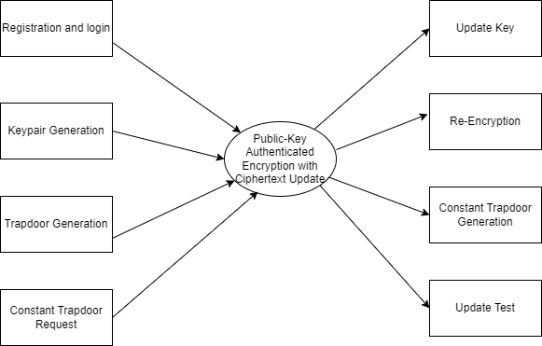
DATA FLOW DIAGRAM LEVEL 1

Slide 44
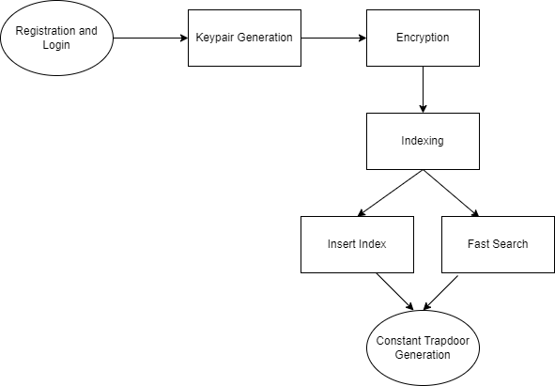
DATA FLOW DIAGRAM LEVEL 2

Slide 45
IMPLEMENTATION
JAVA
Java is a widely-used programming language known for its platform independence, simplicity, and robustness.
It allows developers to write code that can run on any device with a Java Virtual Machine (JVM).
Java is highly versatile and is used for web development, mobile apps, enterprise systems, and more.
Its key features include object-oriented programming, built-in error handling, and support for multithreading.

Slide 46
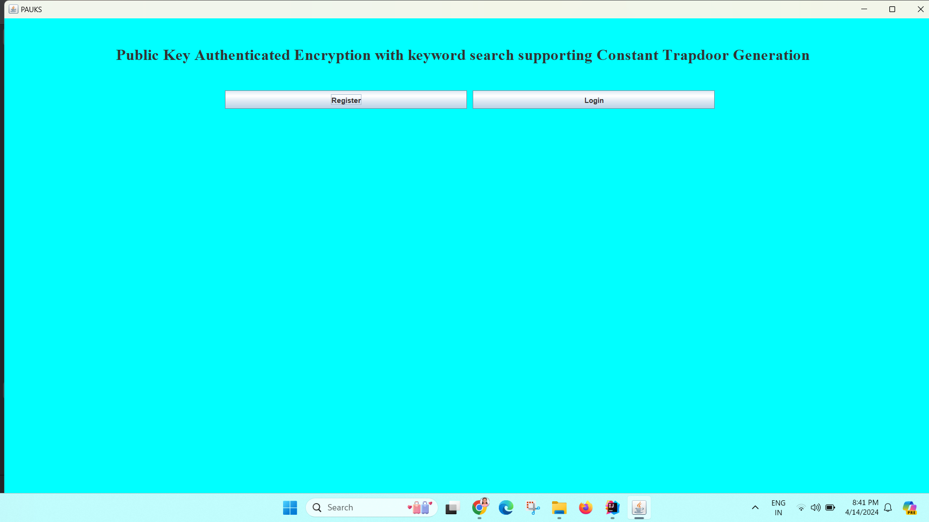
HOMEPAGE

Slide 47
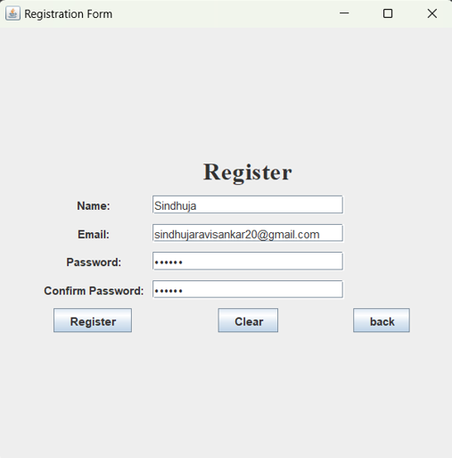
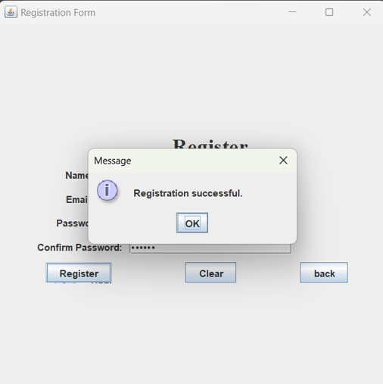
REGISTER

Slide 48
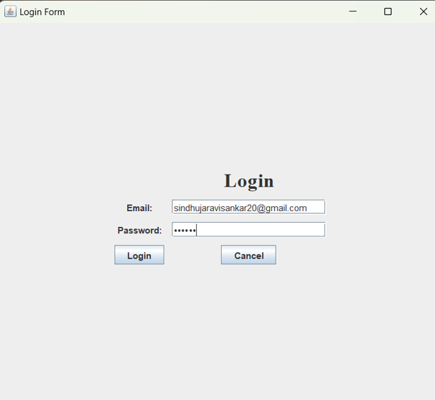
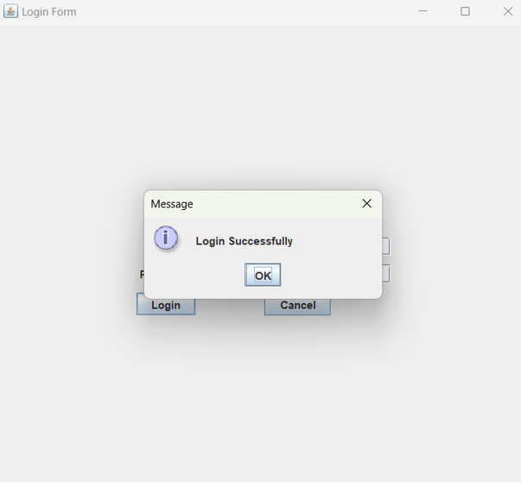
LOGIN

Slide 49
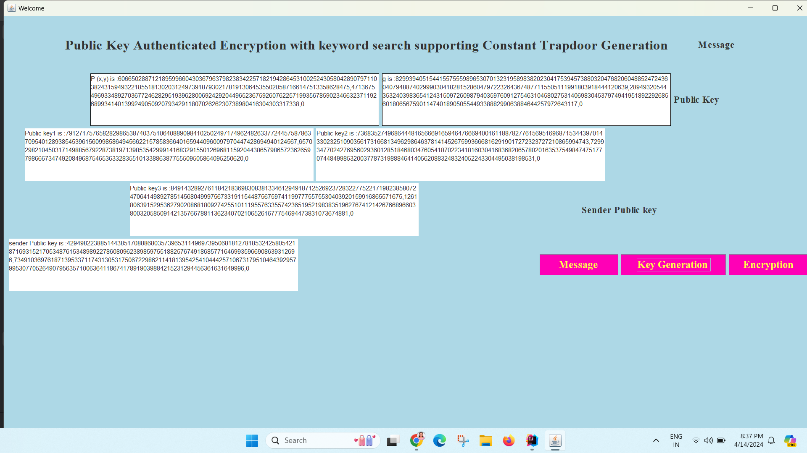
KEY GENERATION

Slide 50
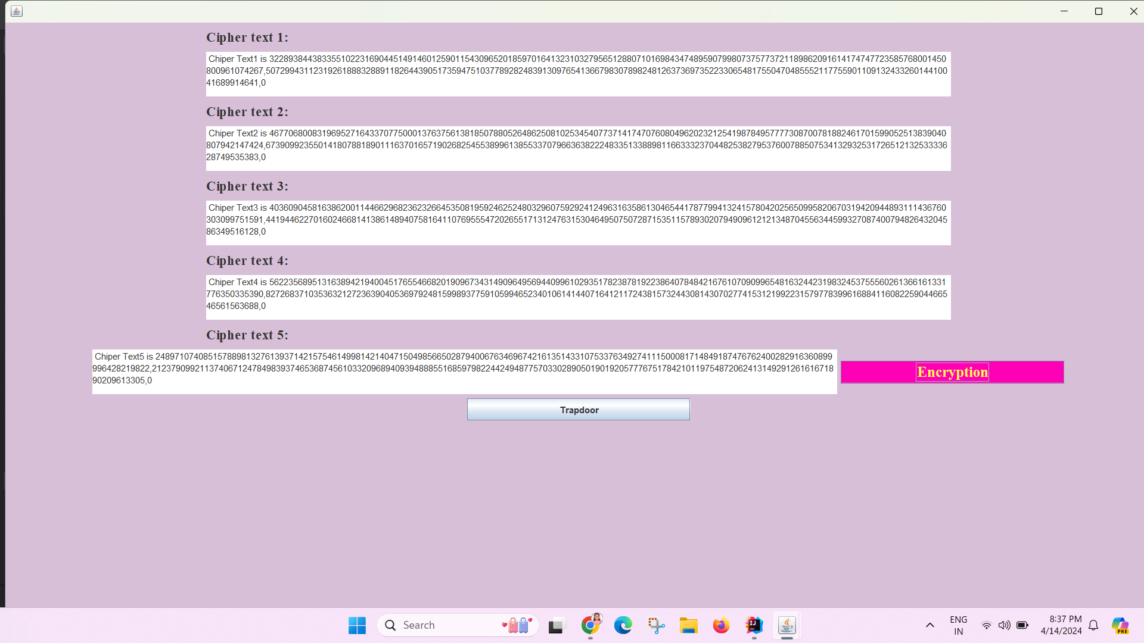
ENCRYPTION

Slide 51
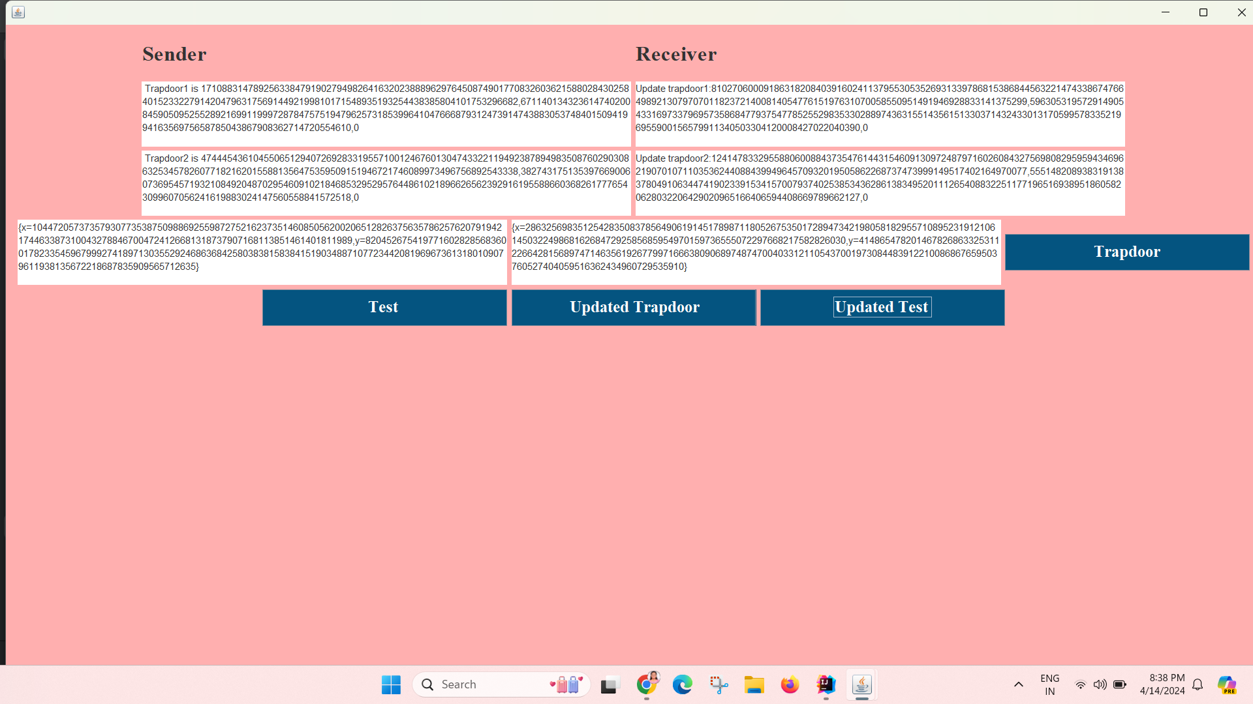
TRAPDOOR GENERATION AND TESTING

Slide 52
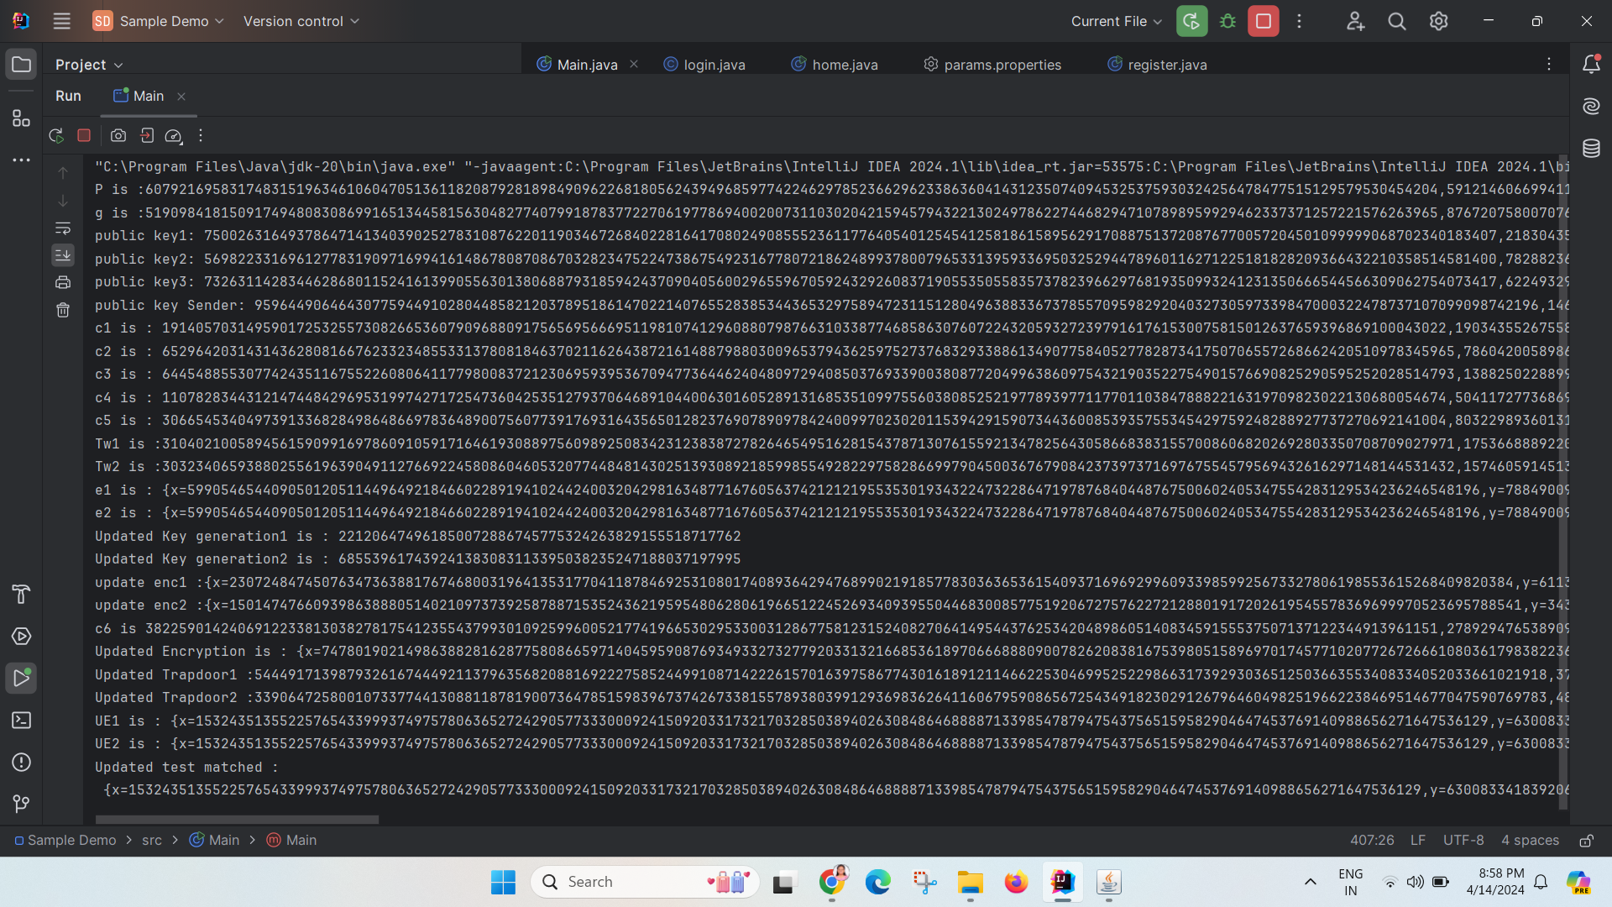
RESULT

Slide 53
PERFORMANCE ANALYSIS
COMMUNICATON OVERHEAD
To evaluate the communication overhead, we construct bilinear pairings e:G × G → GT and terms of ciphertext and the trapdoors.
The PAUKS scheme has a higher but still comparable communication overhead in terms of the ciphertext and the trapdoor, after ciphertext update, the trapdoor communication overhead of our PAUKS scheme reduces to constant complexity.
PAUKS scheme has slightly larger computation overhead than PAEKS scheme in terms of Encryption,Trapdoor and Test algorithms, it enjoys a lower computation complexity when using Constant Trapdoor and Updated Test algorithms to realize ciphertext retrieval.

Slide 54
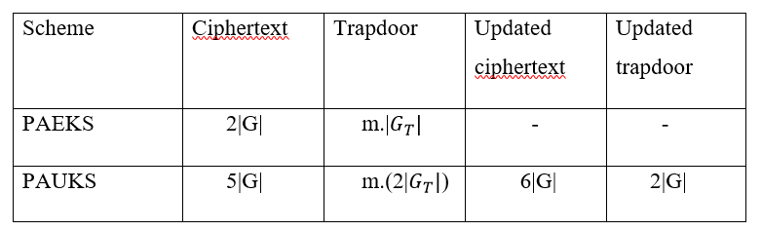
COMMUNICATON OVERHEAD EVALUATION

Slide 55
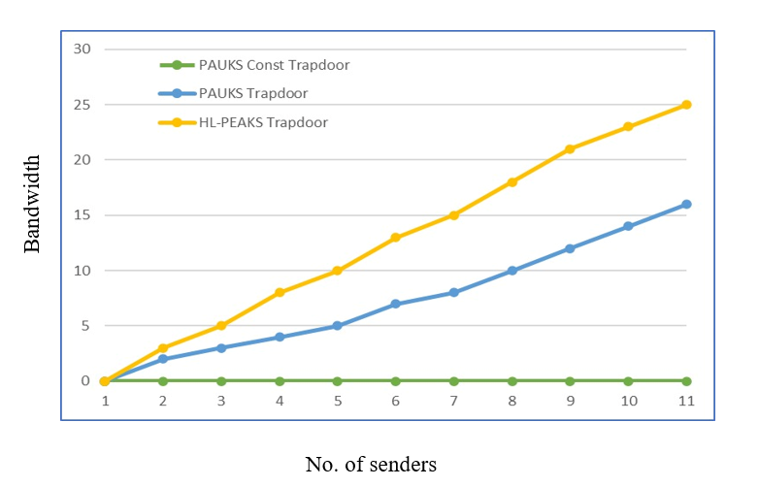
TRAPDOOR BANDWIDTH COST COMPARISON

Slide 56
STORAGE COST
The storage cost of the sender’s keys in both PAEKS and PAUKS scheme needs large storage space that PAEKS in terms of the receiver’s key, ciphertext and trapdoors.
PAUKS supports the constant trapdoor transmission after the updated ciphertext and needs much less the bandwidth when the number of senders is large.
Due to extensional functions, our PAUKS scheme needs larger storage space than HL-PAEKS scheme in terms of the receiver’s keys, ciphertexts and trapdoors.
PAUKS scheme supports constant trapdoor transmission after ciphertext update and needs much less bandwidth when the number of senders is large.

Slide 57
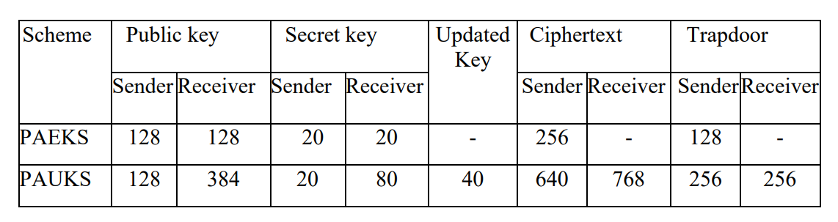
STORAGE COST OF KEYS,CIPHERTEXT AND TRAPDOOR

Slide 58
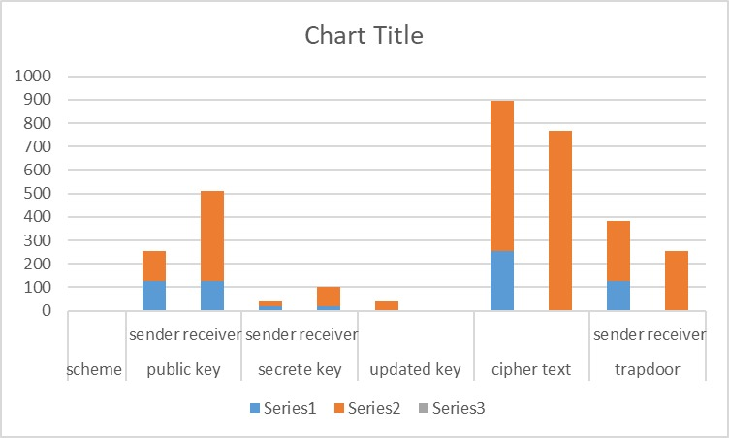
STORAGE COST

Slide 59
CONCLUSION
Our project proposes an EMR system by introducing a public key authenticated encryption with ciphertext update and keyword search (PAUKS) scheme.
Different from preceding PAEKS schemes, the proposed PAUKS scheme reduces trapdoor communication overhead from linear to sub-linear with the help of a noncollusion proxy.
As a result, the proposed PAUKS scheme is compatible with a secure inverted index, which achieves a fast searching efficiency.
The experimental results demonstrate that the PAUKS scheme is a promising solution for secure and efficient storage and sharing of EMRs in cloud environments.

Slide 60
FUTURE WORKS
Future work would concentrate on enhancing the proposed scheme for storing and sharing electronic medical records in cloud servers.
To involve exploring optimizations to further reduce computation and communication overheads, improving the scheme's scalability to handle larger volumes of EMRs, and conducting thorough security evaluations to identify and address potential vulnerabilities.
Additionally, research can be conducted to investigate the integration of emerging technologies such as blockchain and homomorphic encryption in the context of EMR storage and sharing.

Slide 61
REFERENCES
[1] Hongbo Li, Qiong Huang, Jianye Huang, Willy Susilo,” Public-Key Authenticated
Encryption with Keyword Search Supporting Constant Trapdoor Generation and Fast
Search,” IEEE Transaction on Information Forensics and Security, vol. 18, June 2023.
[2] D. Boneh, G. Di Crescenzo, R. Ostrovsky, and G. Persiano, “Public key encryption
with keyword search,” in Advances in Cryptology— EUROCRYPT, C. Cachin and J.
L. Camenisch, Eds. Berlin, Germany: Springer, 2004, pp. 506–522.
[3] H. Li, Q. Huang, J. Shen, G. Yang, and W. Susilo, “Designated server identity-based
authenticated encryption with keyword search for encrypted emails,” Inf. Sci., vol.
481, pp. 330–343, May 2019.
[4] Y. Lu, J. Li, and Y. Zhang, “Secure channel free certificate-based searchable
encryption withstanding outside and inside keyword guessing attacks,” IEEE Trans.
Services Comput., vol. 14, no. 6, pp. 2041–2054, Nov. 2021.

Slide 62
REFERENCES
[5] R. Chen, Y. Mu, G. Yang, F. Guo, and X. Wang, “Dual-server public-key encryption
with keyword search for secure cloud storage,” IEEE Trans. Inf. Forensics Security,
vol. 11, no. 4, pp. 789–798, Apr. 2016.
[6] L. Xu, Z. Sun, W. Li, and H. Yan, “Delegatable searchable encryption with specified
keywords for EHR systems,” Wireless Netw., pp. 1–13, Jul. 2020.
[7] M. Deng, W. Song, M. Ma, H. Li, and M. Israr, “Efficient designatedserver proxy re-
encryption with keyword search for big data,” in Proc. Int. Conf. Artif. Intell. Secur.
Cham, Switzerland: Springer, 2022, pp. 364–377.

Slide 63
THANK YOU

